Slide 1
Not Your Grandparent’s PowerOn
Episys Professional Services
Brad Hutchinson & Jacob Clouse

Slide 2

Brad Hutchinson
Software Engineering Manager
15 years in the credit union industry
Experience in external applications, UIs, and interfaces
Programming experience at credit unions, 3rd Party Vendors, and………

Slide 3

Jacob Clouse
Implementation Consultant
15 years in the credit union industry
Experienced in everything from mergers to APIs for Episys access
Specializes in the “can’t be done”

Slide 4
Agenda
Professional Services Overview
Programming Menu
Transaction Mapping Demo
SymApp
How Can We Help?
Questions

Slide 5
Professional Services Overview
Provide Episys credit union clients with analyst and programming resources to assist clients with custom programming needs.
Offer many products and services including ELA, EMA, & SymApp.
Create interfaces to 3rd party vendors through Symitar’s Vendor Integration Program (VIP)
Provide dedicated support

Slide 6








Programming Menu

Slide 7
Programming Ingredients
HTML PowerOns
PowerOn Reports
SymformPDF
Symform
Symconnect & SymXchange PowerOns
APIs
Web Services (SOAP, Rest)
3rd Party Integrations
SymXchange

Slide 8
Programming Dishes
HTML PowerOns
Interface externally with JavaScript
GUI enhancements with jQuery, Angular, HTML5
Address Verification
Email Return Processing
Membership & Loan Applications
Vendors that won’t program to Episys

Slide 9
Transaction Mapping
Member Need
My wife and I share a checking account.
My wife spends money all over the metro-Atlanta area.
I pay our bills.
When I pay bills the transaction description is sometimes very vague.
I holler across the house at my wife and ask her if she spent $X on some date.
I get in trouble for questioning how my wife spends money.

Slide 10
Transaction Mapping
User Story
AS A Member Service Rep I WANT to provide members with the ability to identify where a transaction occurs SO THAT spouses who share checking accounts will no longer get in trouble.

Slide 11
The Demo

Slide 12
Technologies Used
Node.js
The web server
Express
SOAP
Angular JS
The front end router and controllers
Skeleton CSS
Minimal design framework

Slide 13
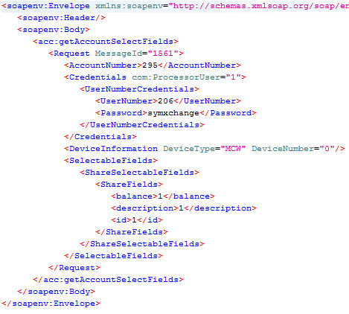
The SymXchange Piece
This is a request to get a list of shares on an account using the Soap UI program

Slide 14
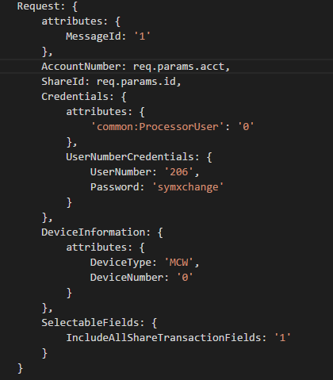
The SymXchange Piece
Node.js leverages a very similar syntax
This is different from .net or Java consumption of a Soap web service

Slide 15
The SymXchange Piece
The Node.js SOAP module allows us to create our request envelope using a JavaScript object
The JavaScript object is serialized into the XML envelope when the request is sent
We receive a JavaScript object back as the response data
This means we never deal with XML directly

Slide 16


Angular Filters
Angular offers very simple filtering
With one input box and one statement in the ng-repeat, you offer full text filter to the entire data set

Slide 17
How Could You Extend This?
Quick display of all transactions on a map to spot out of band transactions
Plot your credit union ATMs against where the most frequent ATM transactions are made

Slide 18
What is SymApp?
A configurable online/mobile solution that allows applicants to:
Establish Membership
Open Accounts
Apply for Loans
Captures single input for multiple products
Integrates with ELA/EMA for account and loan funding

Slide 19
SymApp Features
Delivers automated decision making
Decision engine is shared by ELA/SymApp
Presents pre-approved cross-sell and refinance offers
Integrates with other complimentary JHA/Symitar products
Ability to resume or check status of applications in progress
Responsive interface design allows access on a computer, tablet, or other mobile device
Accommodates credit union branding
Includes user-friendly configuration tools for ongoing CU maintenance

Slide 20
SymApp Foundation
Communicates via SymXchange
Can be installed in-house or hosted with JHA Cloud Services
Integrates with online and mobile banking for existing members
Built to evolve

Slide 21
SymApp Demo Full demo on client portal

Slide 22
Professional Services
How can we help?
Suite of products
PowerOn
3rd Party Integrations
Vendor Integrations
Custom Interfaces

Slide 23
September 12 –15
Hilton San Diego Bayfront
San Diego, CA

Slide 24
Do you have any questions?

